Slide 1



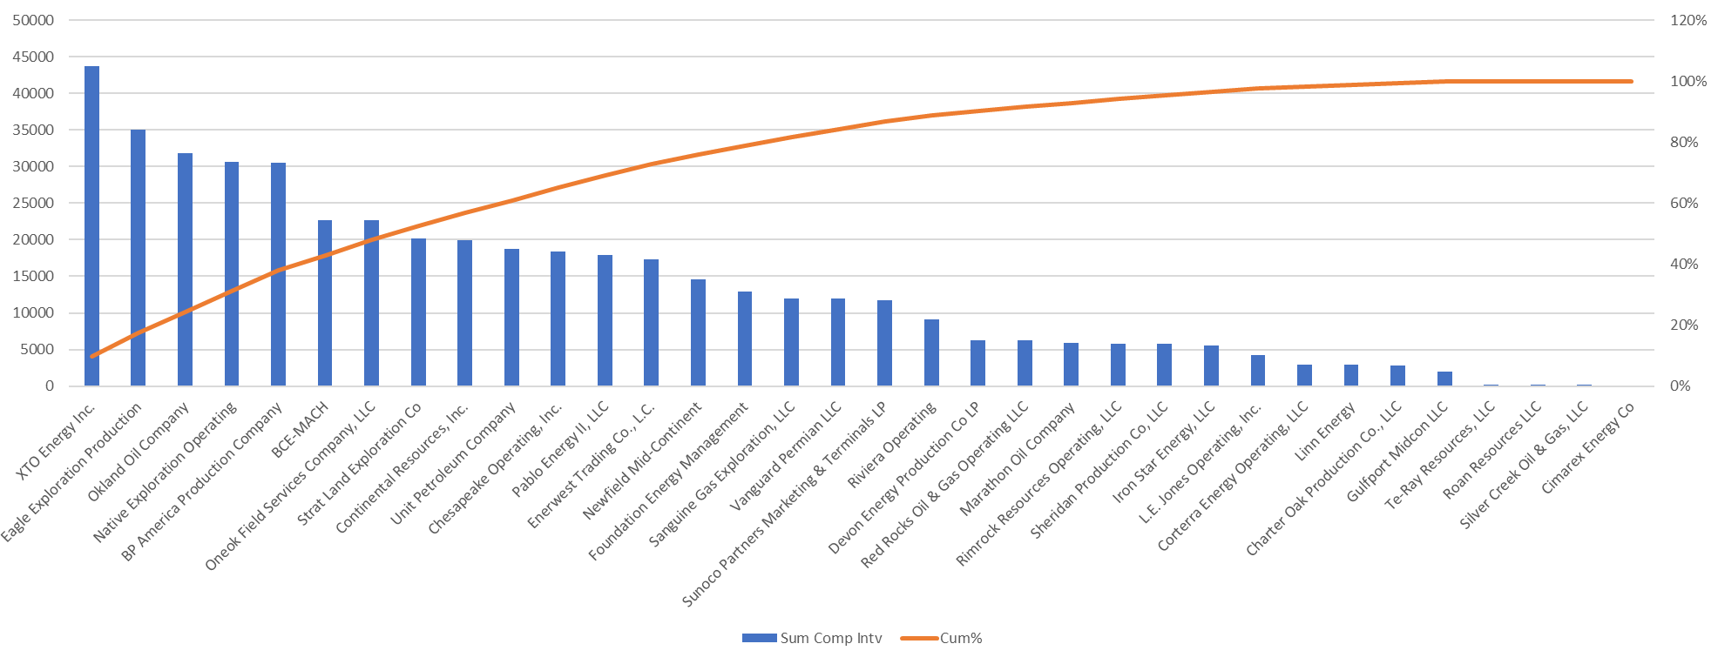
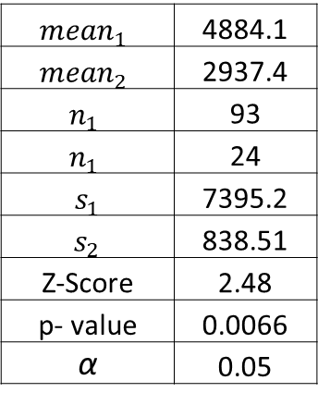



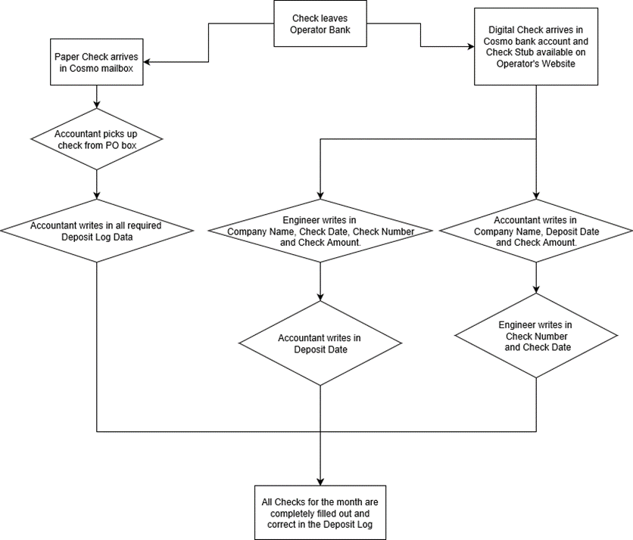

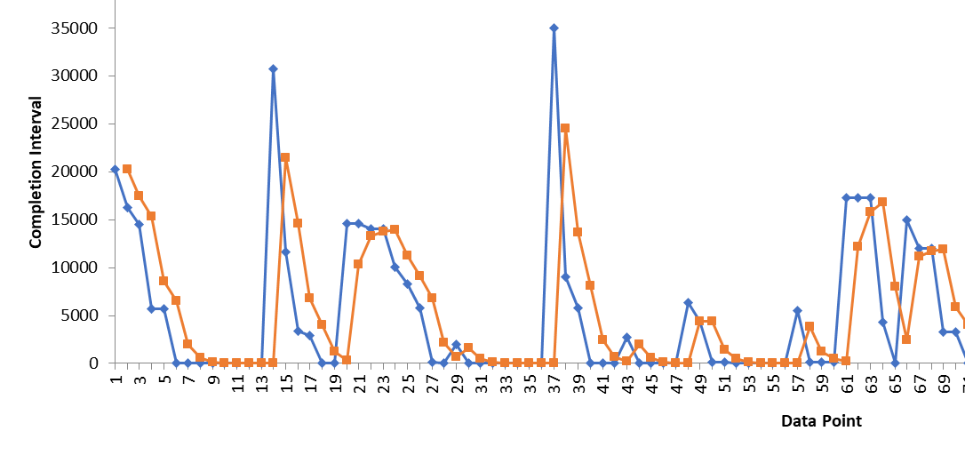
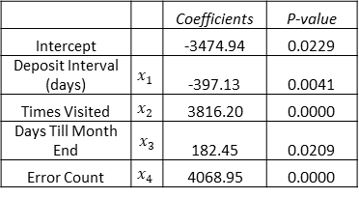
Process Improvement: Check Reconciliation
Process Owner: Samuel Rogers
Key Dates --->
Team Launch
4/06/2019
Define
4/06/2019
Measure
4/09/2019
Analyze
4/20/2019
Improve
5/01/2019
Control
6/01/2019
Team:
DEFINE
MEASURE
ANALYZE
IMPROVE
Sydnee
Problem Statement
Company wastes spending ability by inefficient deposit log system. Engineers hindered by slow deposit system and missing data to meet monthly revenue deadline.
Identify Measure System
Jana
Performance Measure | Data Source and Location | How Will Data Be Collected | Who Will Collect Data | When Will Data be Collected | Target Sample Size
Error Type | Deposit Log Inputs | Compare deposit log inputs with error checked standard | Jordan, Sydnee, Jana | Excel file save date and time | 93
Check Deposit Interval | Deposit Log Inputs | Difference between check data and deposit date | Jordan, Sydnee, Jana | Upon check deposition | 93
Completion Interval | Deposit Log Inputs | Excel time stamp difference of intial and final check input | Jordan, Sydnee, Jana | Upon complete data & error free | 93
Jordan
P <
Statistically
Significant
SQL = 3.3
Pareto Chart reveals longest companies to process are physical paper checks.
Change
Mean Results Improved by 40%
Setup mobile deposit account AND established bank deposit notifications to a shared email address.
SQL = 3.5
CONTROL
Tracking Macros Used Archives to Measure Changes per User
Exponential Smoothing is used to predict future periods of lengthy completion intervals, so team members can prepare. When the St. Dev decreases, I’ll increase damping factor to improve prediction capabilities.
Multiple Linear Regression is statistically significant predictive model for Completion Interval
 |  | Coefficients | P-value
Intercept |  | -3474.94 | 0.0229
Deposit Interval (days) | $x_{1}$ | -397.13 | 0.0041
Times Visited | $$x_{2}$$ | 3816.20 | 0.0000
Days Till Month End | ${ x}_{3}$ | 182.45 | 0.0209
Error Count | $$x_{4}$$ | 4068.95 | 0.0000
Excessive process steps and multiple users increases error and wait time between steps.
Business Case: 25% reduction in process resulting in $7,200 Annual Cost Reduction

Slide 2
– Define –
The purpose of this process improvement project is to deposit checks and show their transaction in the deposit log more quickly.
GOAL: To increase spending ability by decreasing the waiting and processing time by 25%.
Company Impact:
Manager has better control over profit margins
Engineers can process production details attached to check earlier in billing cycle
Missing funds can be requested from debtors more quickly to acquire in time for monthly revenue report
Team:
Accountant, two engineer technicians, and myself as process owner
This is the Completion Interval, explained later

Slide 3
– Define – Process Map

Slide 4

– Define – Operational Definitions:
Defects
Incorrect or missing field in check deposit log:
Check Date, Check Number, Deposit Date, Paying Company, Check Type, Amount
Duplication of check data
Check data incomplete after 5 days of starting (7200 minutes)
Check data incomplete 4 days after months end
Check isn’t deposited within 7 days of check date
Waste
Waiting
Checks sitting in office when they could be cashed
Deposits are not recorded so manager can not account for money
Deposits are not recorded so technicians can not process oil production data
Transportation
Collection of checks from deposit box
Transport of checks to bank

Slide 5
– Define – Operational Definitions:
Check Deposit Interval – Time interval from check date to deposit date
Error Count – Count of errors in deposit log
Deposit Log Error – Incorrect, missing** or duplicate deposit log data
Check Categorization – Checks grouped according to check date month
Complete Data – Filled in data: Check Date, Check Number, Deposit Date, Check Type, Paying Company, Amount
Times Visited – Counts edits till all check fields are correct
Days Till Months End – Difference between Check Date and last day of the month
Completion Interval – Time between initial data till deposit line is Complete and contain no Deposit Log Errors
This is the output (y)

Slide 6
– Measure – Data Measurement System
Performance Measure | Data Source and Location | How Will Data Be Collected | Who Will Collect Data | When Will Data be Collected | Target Sample Size
Error Type | Deposit Log Inputs | Compare deposit log inputs with error checked standard | Jordan, Sydnee, Jana | Excel file save date and time | 116
Check Deposit Interval | Deposit Log Inputs | Difference between check data and deposit date | Jordan, Sydnee, Jana | Upon check deposition | 116
Completion Interval | Deposit Log Inputs | Excel time stamp difference of initial and final check input | Jordan, Sydnee, Jana | Upon complete data & error free | 116
Times Visited | Deposit Log Inputs | Excel time stamps and subsequent edits of a sample | Jordan, Sydnee, Jana | Upon complete data & error free | 116
Measurement Error
Can be reduced by transaction tracking per item entered instead of save date of document. There could be an 8-hour delay if user forgets to save document after data entry.
Only 3 months of data to collect and therefore an uneven distribution of baseline vs. improved data to test.

Slide 7
– Measure – Sample Size
I expected to have more samples, but the timestamps were deleted 3.5 months ago during a database audit. This limited my available sample size as timestamps are crucial to measuring the Completion Interval.
Samples came from March, April, May check months. The acquired sample size of 117 checks is within calculated Target Sample Size of 116. Reduce sample size by decreasing confidence interval and/or increasing error range.
Using an insufficient sample size risks the results not being statistically significant or failing to produce a reasonable representative sample mean of the population mean
Sample Size | 117
Confidence Interval | 90%
Error Range (min) | 1050
Standard Deviation (min) | 6869
Target Sample Size | 116
Sample Size for Continuous Data
I choose an error range of 17.5 hours and 90% confidence interval
These are less than ideal parameters hindered by lack of data.

Slide 8
– Measure – Data Set and Inputs
Table 1) Excerpt of completed data collected and organized by team members
ID | Check Number | Check Date | Deposit Date | Paying Company | Check Type | Check Amount
14 | 104968 | 3/20/2019 | 3/25/2019 | CP Energy, LLC | Physical | $ 161.52
35 | E100628372 | 3/20/2019 | 3/20/2019 | BP America Production Company | ACH | $ 1,525.04
63 | 2690119713 | 3/20/2019 | 4/2/2019 | Newfield Mid-Continent | Physical | $ 56.80
74 | 27207 | 3/20/2019 | 3/25/2019 | Roan Resources LLC | Physical | $ 1,543.17
16 | N/A | 3/21/2019 | 3/21/2019 | Silver Creek Oil & Gas, LLC | ACH | $ 105.19
8 | E100631740 | 3/25/2019 | 3/21/2019 | BP America Production Company | ACH | $ 392.51
58 | N/A | 4/22/2019 | 4/24/2019 | L.E. Jones Operating, Inc. | ACH | $ 532.19
Table 2) Backend calculation of excerpt data above, derived using comparison macros and archived excel sheets. Theses tools document user, time stamp and changes between save sessions
Baseline output (y):
ID | Source (team) | Record Time | Error Count | Times Visited | Date Completed | Deposit Interval (days) | Days till Month End | Error Type & Source | Completion Interval (min)
14 | Sydnee | 3/25/2019 3:29 | 0 | 1 | 3/25/2019 3:29 | 5 | 10 |  | 0
35 | Sydnee | 3/25/2019 3:29 | 1 | 1 | 4/8/2019 4:57 | 0 | 10 | Missing Data | 20248
63 | Jana | 4/2/2019 11:19 | 0 | 1 | 4/2/2019 11:19 | 13 | 10 |  | 0
74 | Sydnee | 3/25/2019 3:29 | 0 | 1 | 3/25/2019 3:29 | 5 | 10 |  | 0
16 | Sydnee | 3/25/2019 3:29 | 0 | 1 | 3/25/2019 3:29 | 0 | 9 |  | 0
8 | Sydnee | 3/25/2019 3:29 | 1 | 3 | 3/29/2019 2:10 | -4 | 5 | Duplicate | 5681
58 | Jana | 4/25/2019 12:30 | 1 | 2 | 4/29/2019 12:00 | 2 | 8 | Missing Data | 4290
-All data collected is discrete except Dates, Interval Times and Check Amounts.

Slide 9
– Analysis – Pareto Chart
By identifying the lengthiest companies, I can focus my improvements to decrease the overall completion interval more effectively.
Companies with 0 min completion interval (ie. processed same day) were excluded due to lack of a practical, graphical, statistical significance.
Wow XTO, lets get you low!

Slide 10
– Analysis – Chi Square Test
Identify problematic fields
Identify problematic fields
Identify major defects
Ho: People and Number of Errors are Independent
Ha: People and Number of Errors are Dependent
P = 2.47E-06 and using alpha = 0.05
2.47E-06 < 0.05, thus reject null hypothesis.
People and Error Type are
dependent variables.
Actual Observed | Error Type
 | Duplicate | Incorrect Data | Late Completion | Missing Data | Totals
Jana | 2 | 10 | 28 | 6 | 46
Jordan | 0 | 0 | 0 | 1 | 1
Sydnee | 0 | 3 | 3 | 1 | 7
Totals | 2 | 13 | 31 | 8 | 54
Expected | Error Type
 | Duplicate | Inncorrect Data | Late Completion | Missing Data
Jana | 1.70 | 8.52 | 23.85 | 5.11
Jordan | 0 | 0 | 0 | 0
Sydnee | 0 | .389 | .389 | 0
Chi Square was used to test the dependence of Error Type on the people inputting data. This is relevant to the y-output as it’s reasonable to assume errors effect quality and ultimately the completion interval.

Slide 11
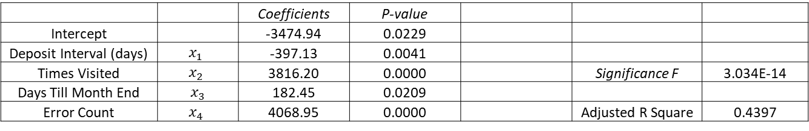
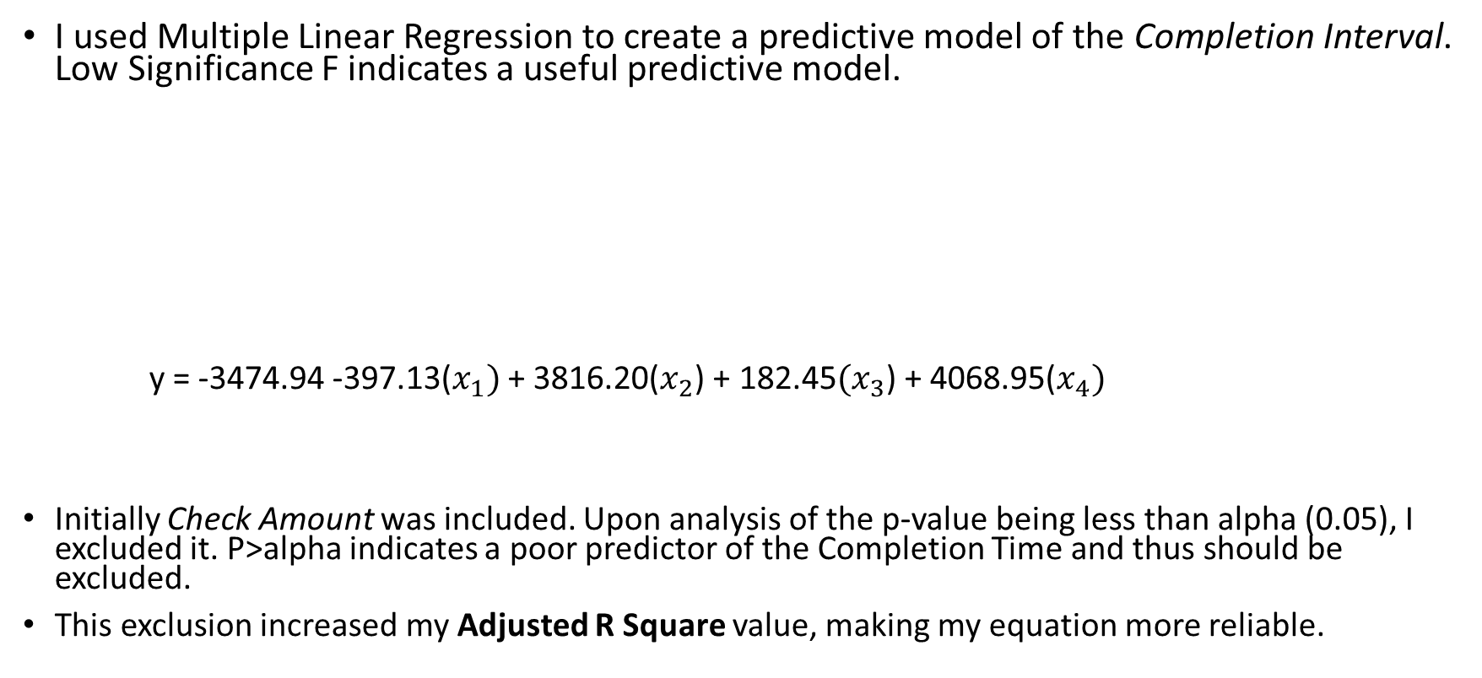
– Analysis – Multiple Linear Regression
I used Multiple Linear Regression to create a predictive model of the Completion Interval. Low Significance F indicates a useful predictive model.
y = -3474.94 -397.13($x_{1})$ + 3816.20($x_{2}$) + 182.45${(x}_{3}$) + 4068.95($x_{4})$
Initially Check Amount was included. Upon analysis of the p-value being less than alpha (0.05), I excluded it. P>alpha indicates a poor predictor of the Completion Time and thus should be excluded.
This exclusion increased my Adjusted R Square value, making my equation more reliable.
All P- values statistically significant to alpha
 |  | Coefficients | P-value
Intercept |  | -3474.94 | 0.0229
Deposit Interval (days) | $x_{1}$ | -397.13 | 0.0041
Times Visited | $$x_{2}$$ | 3816.20 | 0.0000 |  | Significance F | 3.034E-14
Days Till Month End | ${ x}_{3}$ | 182.45 | 0.0209
Error Count | $$x_{4}$$ | 4068.95 | 0.0000 |  | Adjusted R Square | 0.4397

Slide 12
– Analysis – SQL
Sigma Quality Level (SQL): Baseline SQL was calculated in order to measure the effect of the changes to my process.
Upon Completion of the project, the S.Q.L. increased by 0.2. Details on this improvement are explained in the Improve phase
Baseline:
SQL 3.3
D | Opportunities for errors or lengthy check processing | 15
U | Units per Cycle | 93
D x U | Defect Opportunities | 1395
A | Actual Defects | 51
A / DU | DPO | 4%
DPO x 1 E6 | DPMO | 36,559
Improved Process:
SQL 3.5
D | 15
U | 26
D x U | 390
A | 10
A / DU = DPO | 3%
DPMO | 25,641

Slide 13
– Improve – Solutions
Chi Square test indicates dependent relationship between People and Error Type. I spoke with our accountant Jana about the many Late Completion, Missing Data, and Incorrect Data errors. These were mostly attributed to a lack of familiarity with the operational definitions.
Incorrect Data was vastly attributed to varied spelling of a company’s name. This was resolved by creating a drop-down list of every paying company.
Pareto Chart showed the companies with the greatest Completion Intervals were physical checks (paper) which require pick up from the PO Box and delivery to the bank.
A call to the bank established deposit notifications to a shared team email and an increased mobile deposit limit of $50,000 per day.
I was unable to forward the PO box to our address as we plan on moving soon.
Automates human input
Automates human input

Slide 14
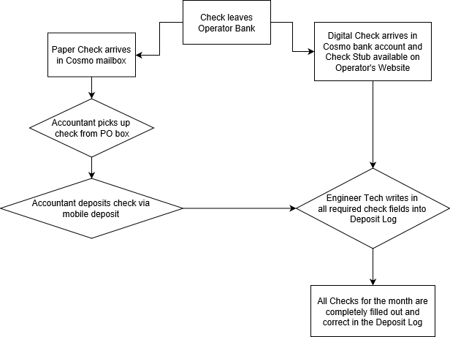
– Improve – Process Map
Three Process steps Removed
Requires a single person to complete a deposit log entry
Eliminates Waste via Transport
Less likely to forget or duplicate data
Timely completion is most important to engineer techs Jordan & Sydnee, as it hinders their work later on. The new system empowers them to stay on schedule.

Slide 15

– Improve – Hypothesis Test & Results
Two sample for Continuous Data: Green Chart
${\text{H}}_{o}$: ${\text{μ}}_{1}$ $≤$ ${\text{μ}}_{2}$
${\text{H}}_{a}$: ${ \text{μ}}_{1}$ $>$ ${\text{μ}}_{2}$
Improvements better than expected
$${mean}_{1}$$ | 4884.1
$${mean}_{2}$$ | 2937.4
$$n_{1}$$ | 93
$$n_{1}$$ | 24
$${ s}_{1}$$ | 7395.2
$${ s}_{2}$$ | 838.51
Z-Score | 2.48
p- value | 0.0066
α | 0.05
Results of the process improvement show a 40% decrease in the Completion Interval. This was greater than the 25% goal value.
These are great results, but an actual decrease of 40% may have changes if there were equal checks deposited in the final result driven month.
p-value < alpha
0.0066 < 0.05
P- value is less than alpha, thus the Null Hypothesis is rejected.
This means the data is statistically significant at alpha = 0.05 and that the difference in the mean process speed is too large to be explained by just chance.

Slide 16
– Control – Exponential Smoothing & Future Steps
This trend will be used to predict greater Completion Intervals in the future
Implemented Changes
The Completion Interval was sorted based on team member start date. This Exponential Smoothing model shows both a prediction of the next check’s expected Completion Interval, and the effects of the process improvements.
The X axis is ordered by start date. This measures incremental improvement.
Damping factor of 0.3 was selected, giving 70% weight to previous start times and 30% to forecasted values.
Moving Forward: Slope of data is decreasing. If it continues, I’ll increase the damping factor to 0.5 since there will be less variation. This will make the model a better forecasting tool.

